Slide 1
Server & Firebase
Software Studio 軟體設計與實驗
Hung-Kuo Chu
Department of Computer Science
National Tsing Hua University
CS2410

Slide 2
Codeblock Conventions
HTML5 Program
JavaScript Program
JSON or Rule

Slide 3



Basic Web Workflow
Request: Website
Response: IP address
DNS Server
Client
Request: IP address
Response: Data
Main Server

Slide 4


Web Architecture
Client
Server
Database
Server returns webpage to Client
Database returns data to Server
D B
Client sends requests to Server
Server queries data from Database

Slide 5
Client
Client (Frontend)
Send requests to Server.
Process/Display data received from Server via Web Browser.
HTML + CSS + Javascript can build a good interactive website
We cannot keep any data
We cannot collect data

Slide 6
Server
Server (backend)
save data in server
do some private function
collect data and display to client
Database
save some txt data
Storage
save some multi media data

Slide 7

What is Firebase?
Firebase is an application cloud development platform built by Google.
Help developers quickly set up backend services in the cloud which effectively shorten the application development time.

Slide 8
Why Use Firebase?
A powerful real-time database which makes it an excellent candidate to drive multi-player games.
Full document storage, analytics, hosting, etc.
Using JavaScript API and provide user side high security.

Slide 9
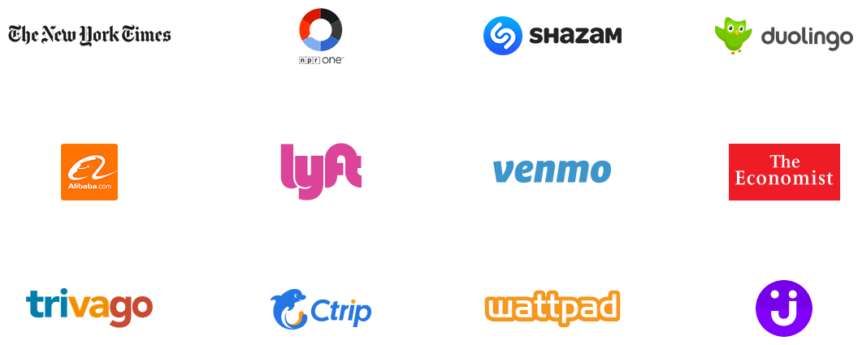
Who are Using Firebase?

Slide 10





What Will You Learn?
Firebase has a lot of features and we will teach you

Slide 11
Step by step
1. Create a new Firebase Project
2. Create a new Web App on Firebase Console
3. Activate Firebase Features
(Authentication, Database, Hosting…)
4. Install the Firebase CLI
5. Import Firebase SDK
6. Run Your Webpage

Slide 12
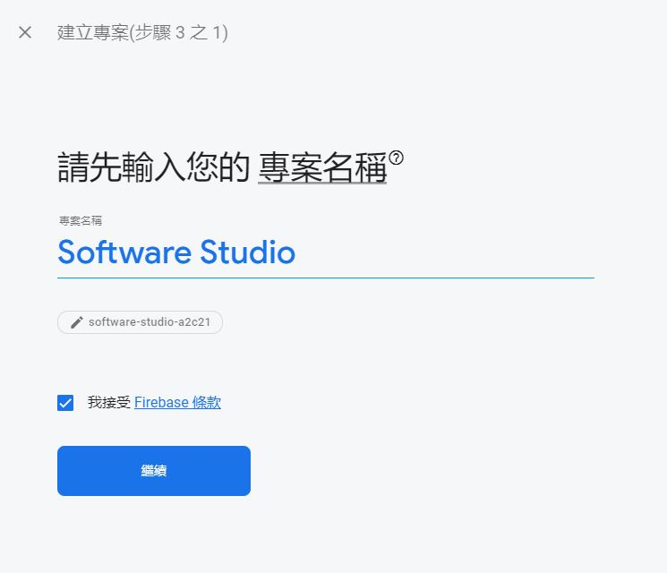
1. Create a new Firebase Project
Go to Firebase Console (need a Google account) and add a project
This id will be used in database URL and webpage domain.
Please record it!

Slide 13
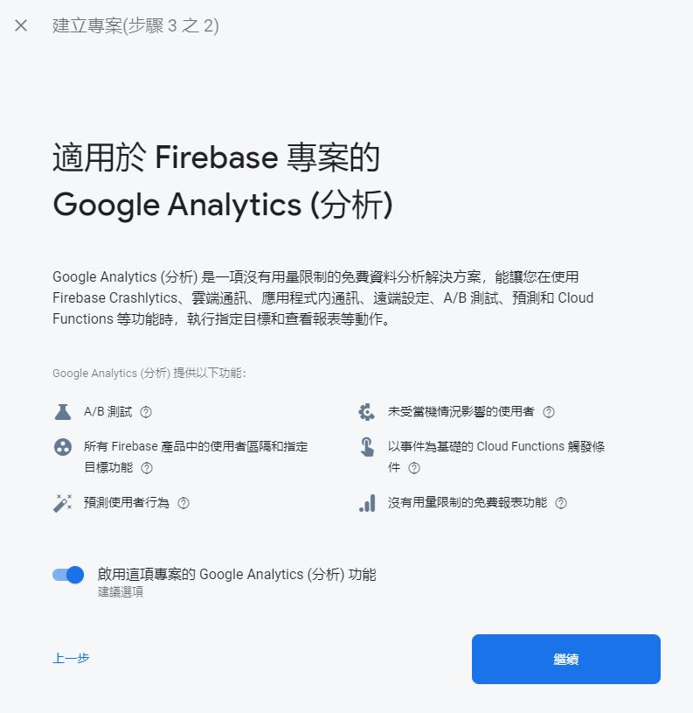
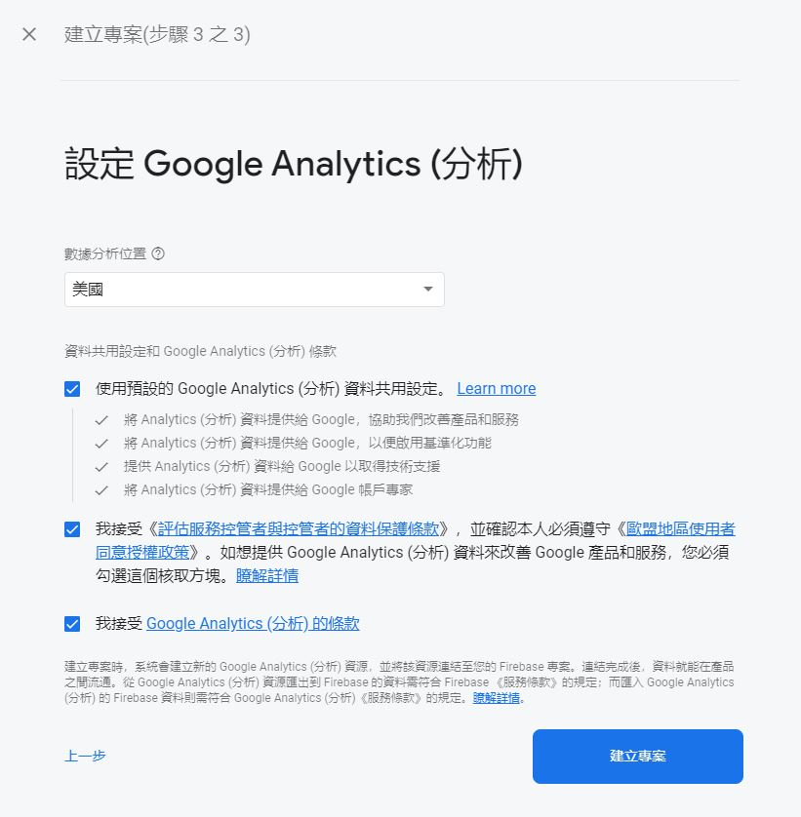
1. Create a new Firebase Project
Then finish remaining steps.

Slide 14
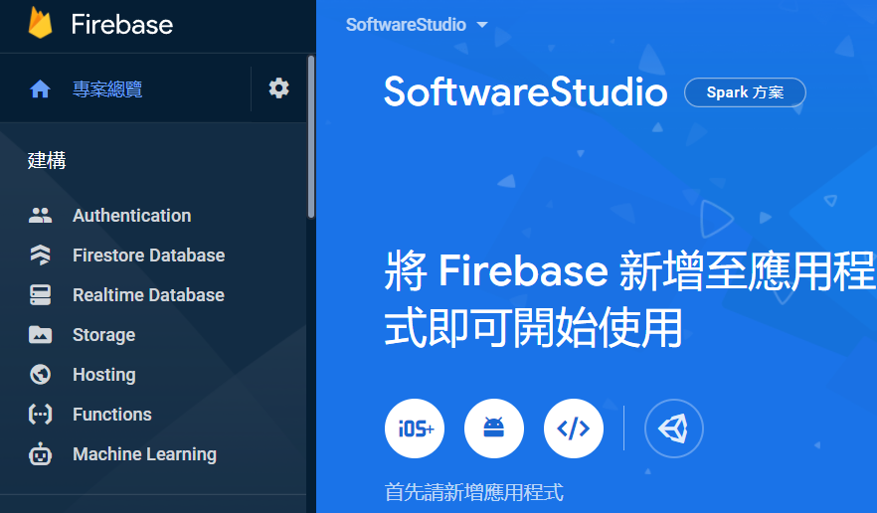
2. Create a new Web App on Firebase Console
Firebase Console

Slide 15
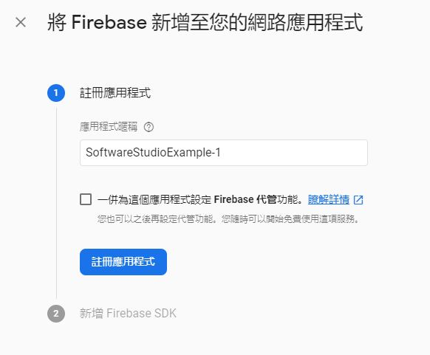
Initialization Configuration
Pick a name for your application

Slide 16
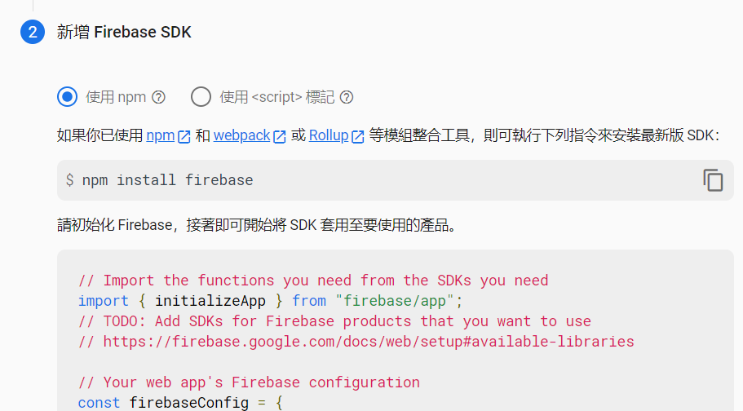
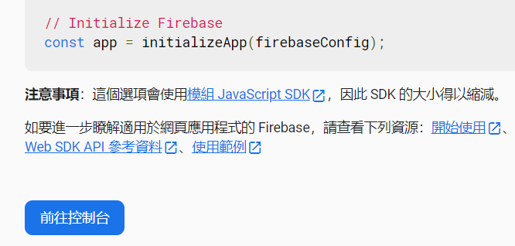
Initialization Configuration
We will import Firebase SDK later

Slide 17
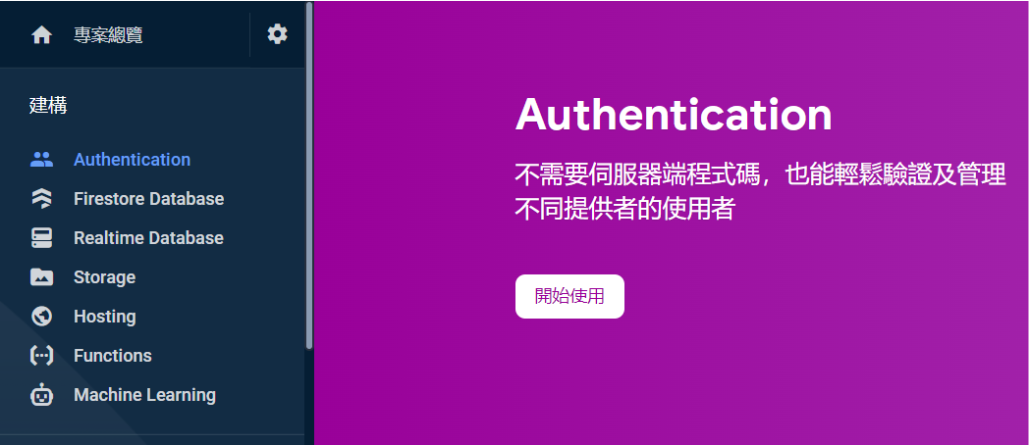
3. Activate Firebase Features
Activate the firebase features you want to use one by one. (Authentication, Database, Hosting…)

Slide 18
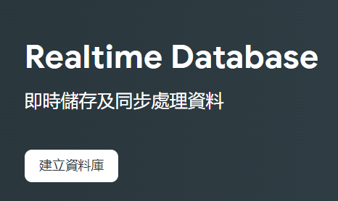
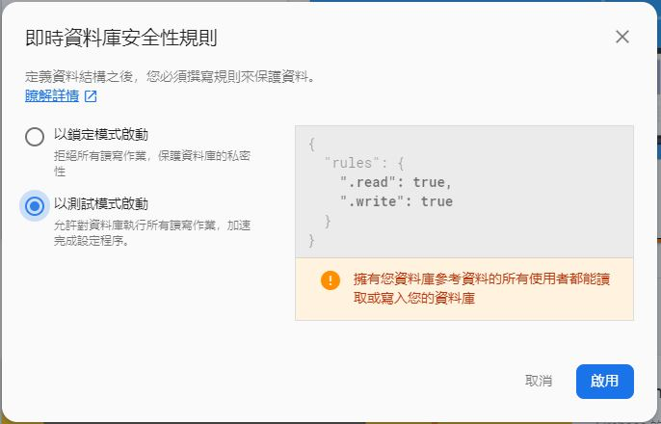
3. Activate Firebase Features

Slide 19
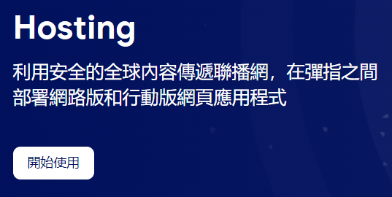
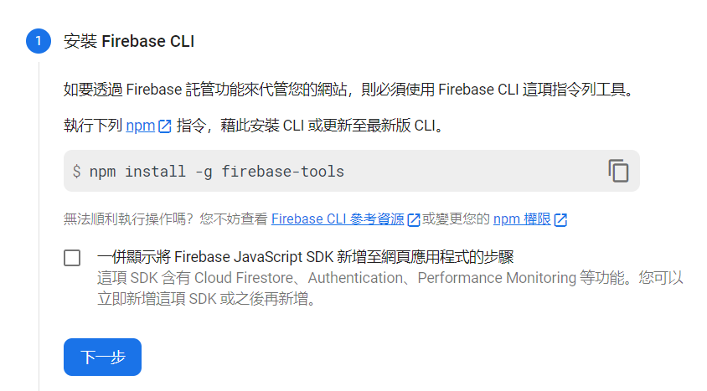
3. Activate Firebase Features

Slide 20
4. Install the Firebase CLI
Download node.js, 12.16.2 LTS
Run the command at your project directory and complete all settings
npm install -g firebase-tools
firebase login
firebase init

Slide 21
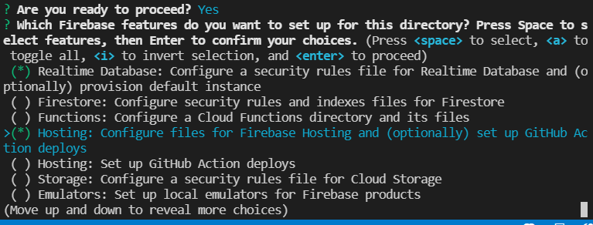
Firebase Initialization
Press <space> to select Firebase features.

Slide 22
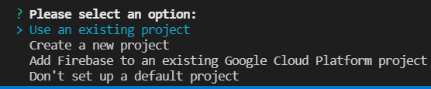
Firebase Initialization
On default Firebase project selection, select your project
If you could not see the project you just create on firebase’s console, you can directly add after initialization, so just select [don't setup a default project]
Run “firebase list” and select one ID
Use “firebase use [ID]” to link your project

Slide 23
Firebase Initialization
Use default setting in other selections
Notice that if your application wants to use any firebase features, it need to be activated first. Otherwise, you can’t set it in firebase init.

Slide 24
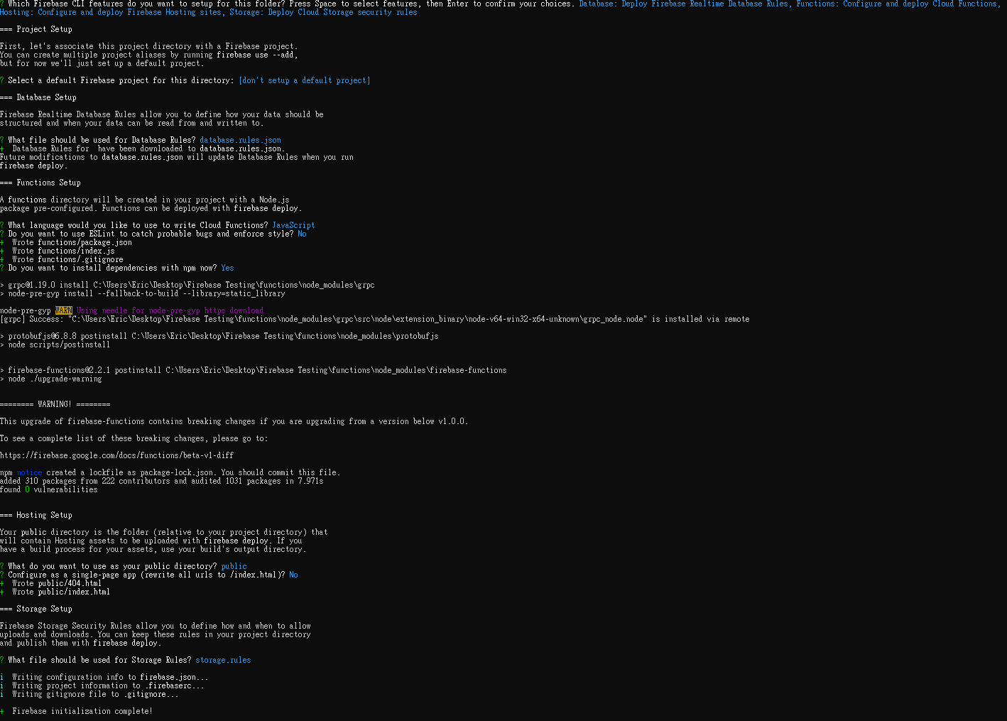
Firebase Initialization

Slide 25
5. Import Firebase SDK
Add Firebase SDK to your .html
firebase: Firebase core
firebase-app: The core Firebase client
firebase-auth: Firebase Authentication
firebase-database: Firebase Realtime Database
firebase-storage: Cloud Storage
<!-- Firebase App is always required and must be first -->
<script src="https://www.gstatic.com/firebasejs/7.8.2/firebase-app.js"></script>
<script src="https://www.gstatic.com/firebasejs/7.8.2/firebase-auth.js"></script>
<script src="https://www.gstatic.com/firebasejs/7.8.2/firebase-database.js"></script>
<script src="https://www.gstatic.com/firebasejs/7.8.2/firebase-firestore.js"></script>
<script src="https://www.gstatic.com/firebasejs/7.8.2/firebase-functions.js"></script>

Slide 26
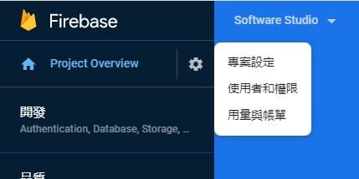
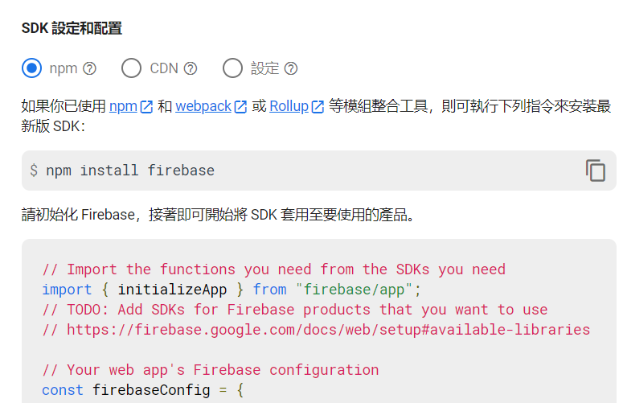
5. Import Firebase SDK
Go to Settings to get the firebaseConfig.

Slide 27
5. Import Firebase SDK
Add Firebase Config to your config.js
Make sure there is databaseURL.
<script src="config.js"></script>
// Initialize Firebase
// TODO: Replace with your project's customized code snippet
const firebaseConfig = {
apiKey: "<API_KEY>",
authDomain: "<PROJECT_ID>.firebaseapp.com",
databaseURL: "https://<DATABASE_NAME>.firebaseio.com",
projectId: "<PROJECT_ID>",
storageBucket: "< PROJECT_ID >.appspot.com",
messagingSenderId: "<SENDER_ID>", appId: "<APPLICATION_ID>", measurementId: “<AnalyticsSDK>"
};
const app = initializeApp(firebaseConfig);

Slide 28
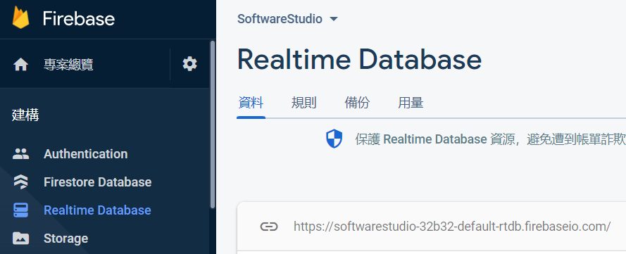
5. Import Firebase SDK
If databaseURL is missing. You can find it in firebase console.

Slide 29
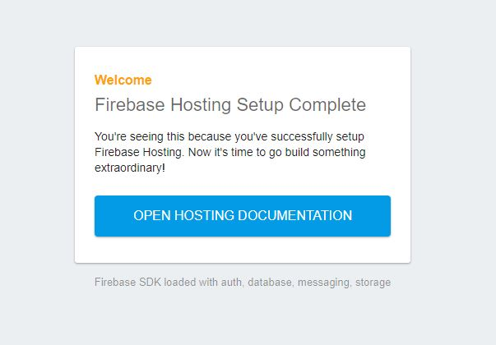
6. Run Your Webpage
You can run a local server for testing
Put all your web files(.html, .js, images…etc.) under the public folder
Run the command at your project directory
firebase serve
Your webpage will run on http://localhost:5000

Slide 30

Take a Break!

Slide 31
Hosting
Firebase Hosting has some key capabilities
Served over a secure connection
Fast content delivery
Rapid deployment
One-click rollbacks

Slide 32
Hosting
Run the command at your project directory
firebase deploy
Your app will be deployed to the domain <YOUR-FIREBASE-APP>.firebaseapp.com

Slide 33
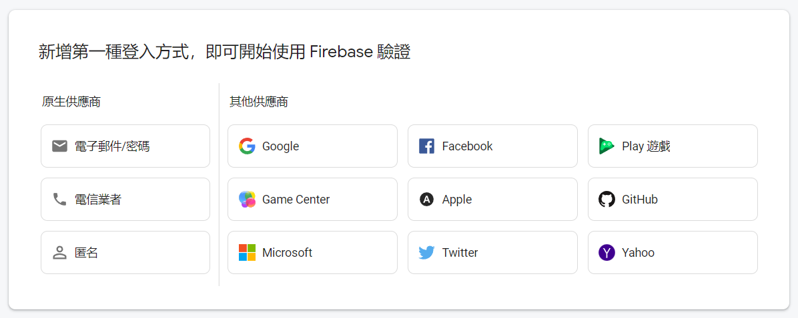
Authentication
You can use Firebase Authentication to allow users to sign in your app using one or more sign-in methods

Slide 34
Authentication
Add your web page domain to Authorized Domains. (You can skip this step if you are using firebase hosting.)
2. Enable the sign-in method
3. Implement authentication with firebase.auth()

Slide 35
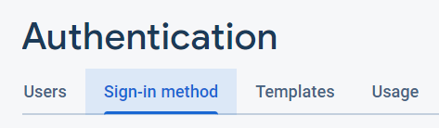
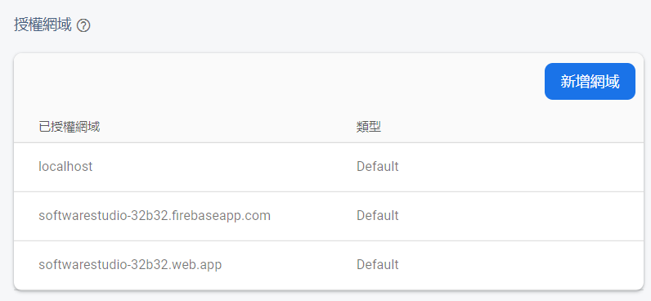
Authorized Domains
Before adding Firebase Authorized to your web page, you need to add your web page domain in firebase console.
For example, your gitlab website url.

Slide 36
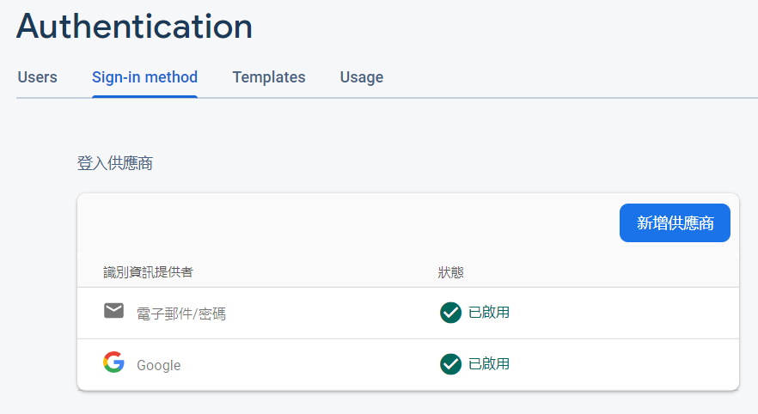
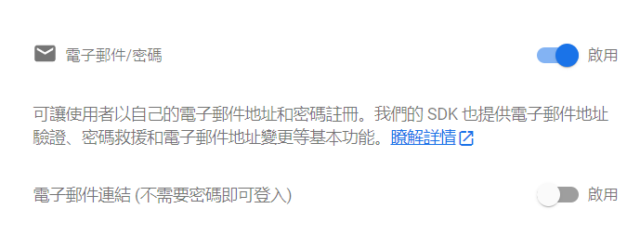
Email/Password Sign-In
Enable the Email/password sign-in method

Slide 37
Email/Password Sign-In
Sign up new users
Sign in existing users
firebase.auth().createUserWithEmailAndPassword(email, password)
.then((userCredential) => {
// Signed in
var user = userCredential.user;
// ...
})
.catch((error) => {
var errorCode = error.code;
var errorMessage = error.message;
// …
});

Slide 38
Email/Password Sign-In
Sign in existing users
firebase.auth().signInWithEmailAndPassword(email, password)
.then((userCredential) => {
// Signed in
var user = userCredential.user;
// ...
})
.catch((error) => {
var errorCode = error.code;
var errorMessage = error.message;
// ...
});

Slide 39
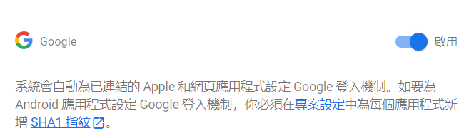
Google Sign-In
Enable the Google sign-in method

Slide 40
Google Sign-In
Create an instance of the Google provider object
var provider = new firebase.auth.GoogleAuthProvider();

Slide 41
Google Sign-In
Sign in with a pop-up window
firebase.auth().signInWithPopup(provider).then(function(result) {
// This gives you a Google Access Token. You can use it to access the Google API.
var token = result.credential.accessToken;
// The signed-in user info.
var user = result.user;
// ...
}).catch(function(error) {
// Handle Errors here.
var errorCode = error.code;
var errorMessage = error.message;
// The email of the user's account used.
var email = error.email;
// The firebase.auth.AuthCredential type that was used.
var credential = error.credential;
});

Slide 42
Google Sign-In
Sign in by redirecting to the sign-in page
firebase.auth().signInWithRedirect(provider);
firebase.auth().getRedirectResult().then(function(result) {
if (result.credential) {
// This gives you a Google Access Token. You can use it to access the Google API.
var token = result.credential.accessToken;
// ...
}
// The signed-in user info.
var user = result.user;
}).catch(function(error) {
// Handle Errors here.
var errorCode = error.code;
var errorMessage = error.message;
// The email of the user's account used.
var email = error.email;
// The firebase.auth.AuthCredential type that was used.
var credential = error.credential;
});

Slide 43

Facebook Sign-In
On the Facebook for Developers site, create a new App

Slide 44
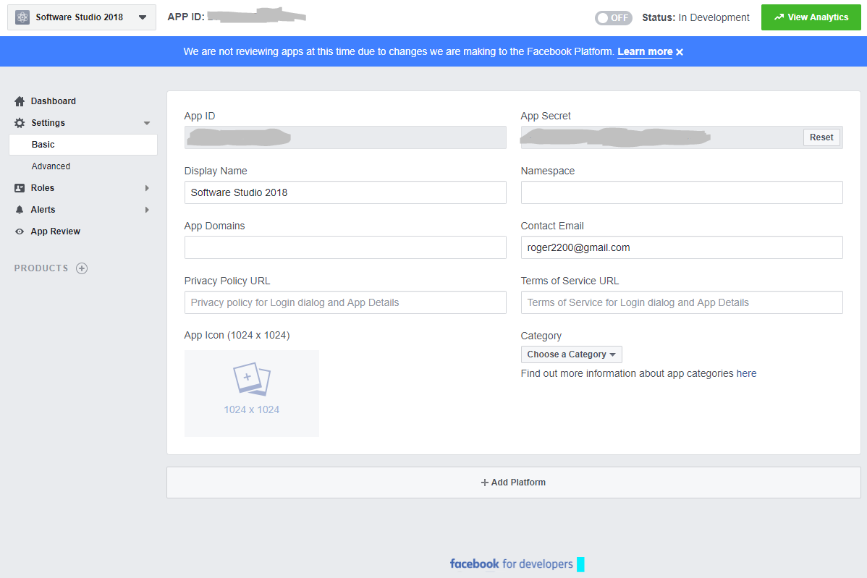
Facebook Sign-In
Get the App ID and an App Secret for your app
(in Facebook for Developer)

Slide 45
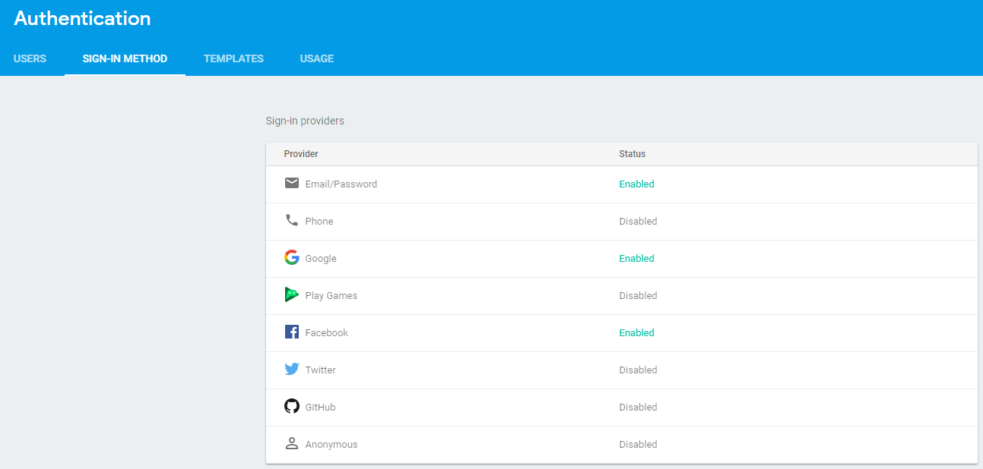
Facebook Sign-In
Enable the Facebook sign-in method
(in firebase page)

Slide 46
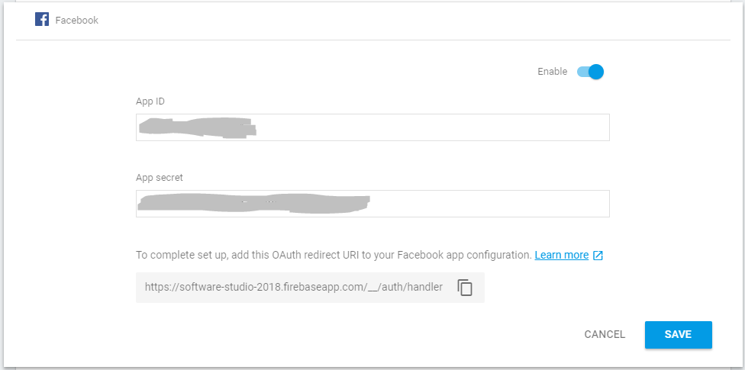
Facebook Sign-In
Add OAuth redirect URL (find in firebase console) in Product Settings > Facebook Login on the Facebook for Developers
(in firebase page)
Notes:
測試者名單或開發者名單裡面
經由臉書認證

Slide 47
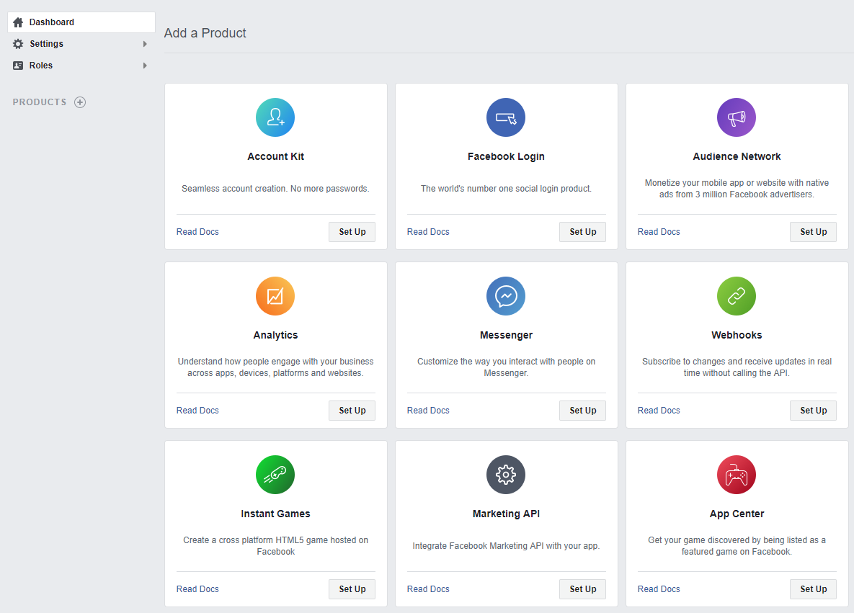
Facebook Sign-In
(in Facebook for Developer)

Slide 48
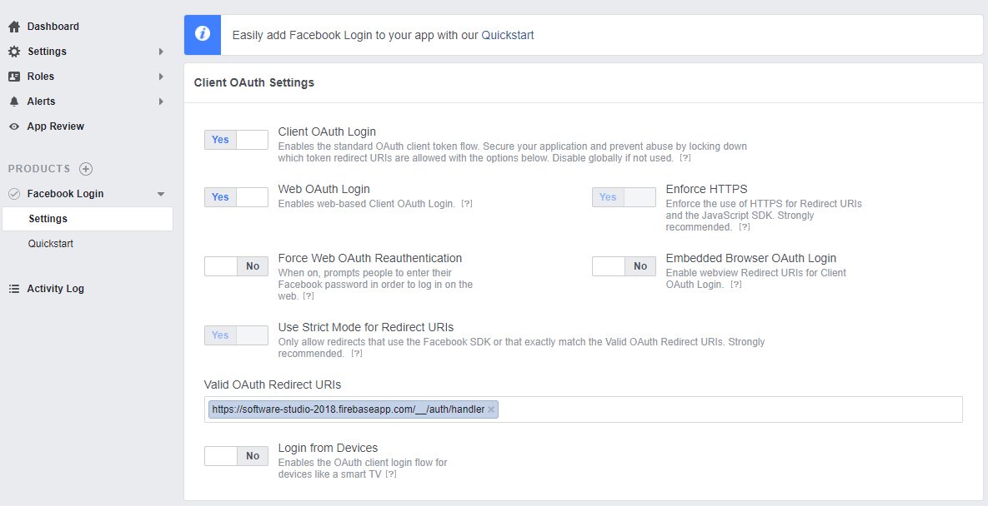
Facebook Sign-In
(in Facebook for Developer)

Slide 49
Facebook Sign-In
Create an instance of the Facebook provider object
var provider = new firebase.auth.FacebookAuthProvider();

Slide 50
Facebook Sign-In
Sign in with popup
firebase.auth().signInWithPopup(provider).then(function(result) {
// This gives you a Facebook Access Token. You can use it to access the Facebook API.
var token = result.credential.accessToken;
// The signed-in user info.
var user = result.user;
}).catch(function(error) {
// Handle Errors here.
var errorCode = error.code;
var errorMessage = error.message;
// The email of the user's account used.
var email = error.email;
// The firebase.auth.AuthCredential type that was used.
var credential = error.credential;
});

Slide 51
Facebook Sign-In
Sign in with redirect
The getRedirectResult() function is shared with google
firebase.auth().signInWithRedirect(provider);

Slide 52
Manage Users
You can get the current user is by setting an observer on the Auth object
firebase.auth().onAuthStateChanged(function(user) {
if (user) {
// User is signed in.
var uid = user.uid;
} else {
// No user is signed in.
}
});

Slide 53
Manage Users
You can also get the currently signed-in user by using the currentUser property
var user = firebase.auth().currentUser;
if (user) {
// User is signed in.
} else {
// No user is signed in.
}

Slide 54
Sign-Out
To sign-out a user, call signOut()
firebase.auth().signOut().then(() => {
// Sign-out successful.
}).catch((error) => {
// An error happened.
});

Slide 55
Reference
https://firebase.google.com/docs/auth/web/start
https://firebase.google.com/docs/reference/js/v8/firebase.auth.Auth

Slide 56
Realtime Database
All Firebase Realtime Database data is stored as JSON objects
Unlike a SQL database, there are no tables or records
{
"users": {
"alovelace": {
"name": "Ada Lovelace",
"contacts": { "ghopper": true },
},
"ghopper": { ... },
"eclarke": { ... }
}
}
database

Slide 57
Read and Write Data
Get a database reference
// Get a reference to the database service
var database = firebase.database();

Slide 58
Write Data
There are 4 ways to write data to the database
set(): Write or overwrite specify reference data
push(): Adding list data, every call to push() will generate a unique ID
update(): Give a key, and update the data of this key will not cover the entire data
transaction(): Updating complex data while updating will cause errors

Slide 59
Write Data
Use ref() to reference the specific path.
Use set() to write data and replace any existing data at that path.
function writeUserData(userId, name, email, imageUrl) {
firebase.database().ref('users/' + userId).set({
username: name,
email: email,
profile_picture : imageUrl
});
}

Slide 60
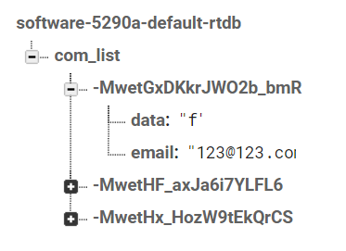
Write Data
Use push() to push data.
Every push() generate a unique key.
Use .key to access it.
function writeUserData(userId, name, email, imageUrl) {
var key = firebase.database().ref(‘com_list’)
.push({data: data, email: email})
.key;
}

Slide 61
Read Data
To read data at a path and listen for changes, use the on() or once() methods of reference to observe events or use query
On: listen for change
Once: for retrive one time, not listen

Slide 62
Read Data
The first parameter of on() and once() is EventType. There are 5 EventTypes.
Use ‘value’ to read the value of that path.
Use ‘child_added’ to read every added child.
var starCountRef = firebase.database().ref('posts/' + postId + '/starCount');
starCountRef.on('value', function(snapshot) {
updateStarCount(postElement, snapshot.val());
});
var userId = firebase.auth().currentUser.uid;
firebase.database().ref('/users/' + userId).once('value').then(function(snapshot){
var username = (snapshot.val() && snapshot.val().username) || 'Anonymous';
});

Slide 63
Read Data
on() and once() receive data as a DataSnapshot object.
Use val() to get the content of the snapshot after you received data.
var starCountRef = firebase.database().ref('posts/' + postId + '/starCount');
starCountRef.on('value', function(snapshot) {
updateStarCount(postElement, snapshot.val());
});
var userId = firebase.auth().currentUser.uid;
firebase.database().ref('/users/' + userId).once('value').then(function(snapshot){
var username = (snapshot.val() && snapshot.val().username) || 'Anonymous';
});

Slide 64
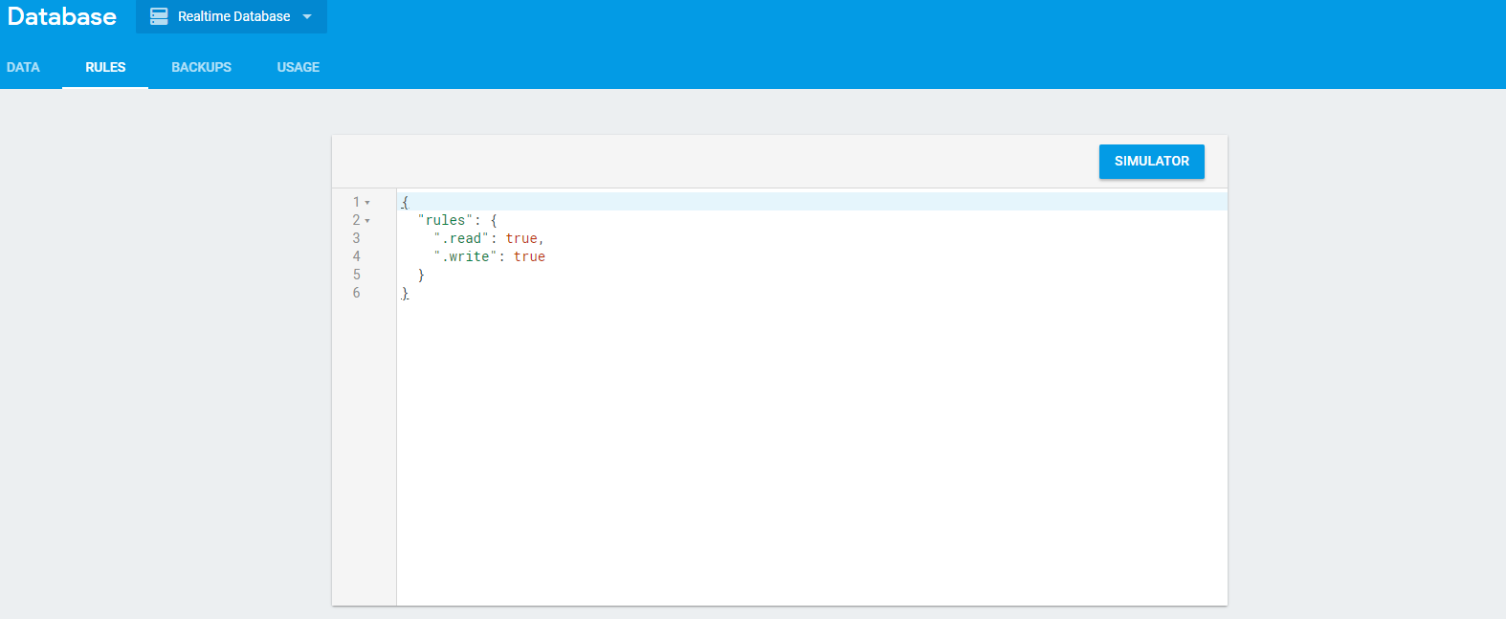
Database Rules
Firebase Realtime Database Rules determine who has read and write access to your database, how your data is structured, and what indexes exist

Slide 65
Database Rules
Rule Types
.read
.write
.validate: Defines what a correctly formatted value will look like, whether it has child attributes, and the data type
.indexOn: Specifies a child to index to support ordering and querying
Notes:
indexOn 提供優化的child幫助排序

Slide 66
Database Rules
For example, here's a set of security rules that allows anyone to read the path /foo/, but no one to write to it
{
"rules": {
"foo": {
".read": true,
".write": false
}
}
}

Slide 67
Database Rules
The Firebase Database Rules include built-in variables and functions
{
"rules": {
"users": {
"$uid": {
".write": "$uid === auth.uid"
}
}
}
}
{
"users": {
“James": { // id 1
“name”:””,
“”
},
“John”:{ // id 2
“name”:””,
“”
}
}
}
rule
Database data
Notes:
當uid跟現今登入的uid相等時 可以進行寫的動作

Slide 68
Database Rules
The rules language includes a .validate rule which allows you to apply validation logic using the same expressions
{
"rules": {
"foo": {
".validate": "newData.isString() && newData.val().length < 100"
}
}
}

Slide 69
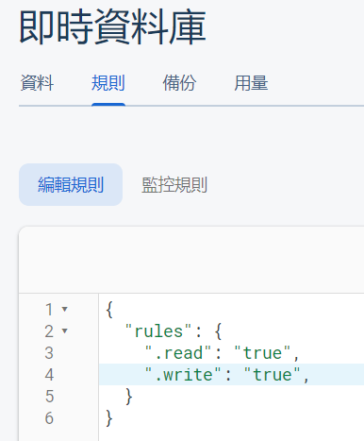
Database Rules
When you changed database.rules.json locally, you must use firebase deploy to update the rule. Otherwise, your changes won't apply.
Or you can change the rules directly on firebase console.

Slide 70
Database Rules
More information and usage about database:
https://firebase.google.com/docs/reference/security/database
https://firebase.google.com/docs/database/web/start#web-version-8
https://firebase.google.com/docs/database/web/read-and-write

Slide 71
Cloud Storage
Cloud Storage for Firebase lets you upload and share user generated content, such as images and video, which allows you to build rich media content into your apps

Slide 72
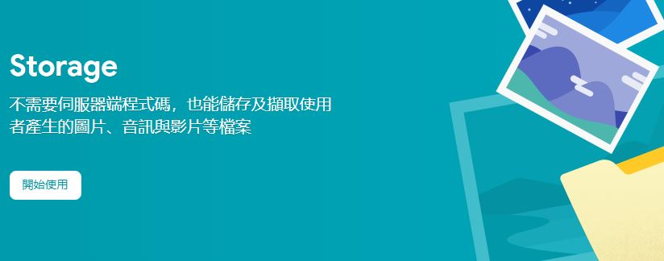
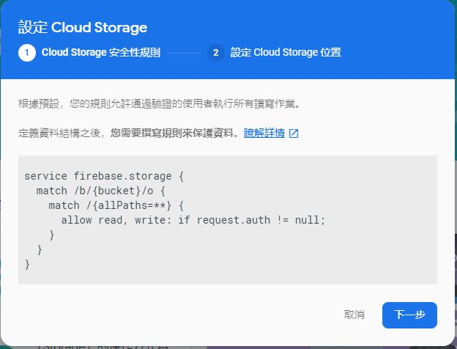
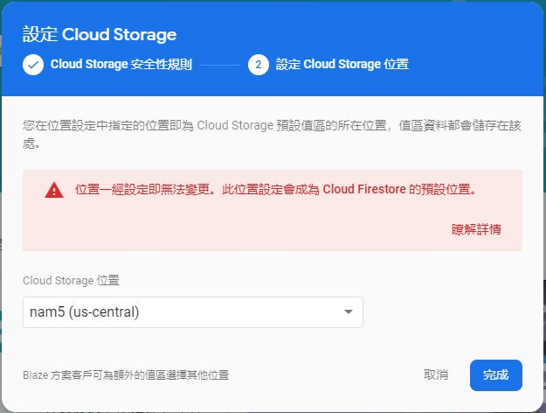
Initialization

Slide 73
Storage Reference
Similar to Database, Cloud Storage need a reference to upload/download files
// Get a reference to the storage service, which is used to create references in your storage bucket
var storage = firebase.storage();
// Create a storage reference from our storage service
var storageRef = storage.ref();
// Create a child reference, imagesRef now points to 'images'
var imagesRef = storageRef.child('images');
// Child references can also take paths delimited by '/’
// spaceRef now points to "images/space.jpg"
var spaceRef = storageRef.child('images/space.jpg');

Slide 74
Upload File
Once you've created an appropriate reference, you then up call the put() method to up;
// Create a root reference
var storageRef = firebase.storage().ref();
// Create a reference to 'mountains.jpg'
var mountainsRef = storageRef.child('mountains.jpg');
var file = ... // use the Blob or File API to get the file
mountainsRef.put(file).then(function(snapshot) {
console.log('Uploaded a blob or file!');
});
//now the file’s reference in database is ‘/mountain.jpg’

Slide 75
Upload File (Cont’d)
// Create a root reference
var storageRef = firebase.storage().ref();
// Create a reference to 'images/mountains.jpg'
var mountainImagesRef = storageRef.child('images/mountains.jpg');
var file = ... // use the Blob or File API to get the file
mountainImagesRef.put(file).then(function(snapshot) {
console.log('Uploaded a blob or file!');
});
//now the file’s reference is ‘/images/mountains.jpg’

Slide 76
Download File
Use getDownloadURL() to get file URL, your can download file directly by this URL or inserted into a HTML element

Slide 77
Download File
Directly download the file
storageRef.child('images/stars.jpg').getDownloadURL().then(function(url) {
// `url` is the download URL for 'images/stars.jpg'
// Download the file directly
var xhr = new XMLHttpRequest();
xhr.responseType = 'blob';
xhr.onload = function(event) {
var blob = xhr.response;
};
xhr.open('GET', url);
xhr.send();
}).catch(function(error) {
// Handle any errors
});

Slide 78
Download File (Cont’d)
Insert file into html element
storageRef.child('images/stars.jpg').getDownloadURL().then(function(url) {
// `url` is the download URL for 'images/stars.jpg'
// inserted into an <img> element:
var img = document.getElementById('myimg');
img.src = url;
}).catch(function(error) {
// Handle any errors
});

Slide 79
Cloud Storage Rules
Storage Security Rules manage the complexity for you by allowing you to specify path-based permissions
// Rules can optionally specify a condition
allow write: if <condition>;
Storage Rules
service firebase.storage { // The {bucket} wildcard indicates we match files in all Cloud Storage buckets match /b/{bucket}/o { // Match filename match /filename { allow read: if <condition>; allow write: if <condition>; } } }
Storage Rules

Slide 80
Cloud Storage Rules
You can also specify the file size
// Rules can specify conditions that consider the request
service firebase.storage { match /b/{bucket}/o { match /images/{imageId} { // Only allow uploads of any image file that's less than 5MB allow write: if request.resource.size < 5 * 1024 * 1024 && request.resource.contentType.matches('image/.*'); } } }
Storage Rules

Slide 81
Cloud Storage Rules
More information and usage about cloud storage rules:
https://firebase.google.com/docs/storage/security

Slide 82
Cloud Function
Cloud Functions let you automatically run backend code in response to events triggered by Firebase features and HTTPS requests.
Your code is stored in Google's cloud and runs in a managed environment. There's no need to manage and scale your own servers.

Slide 83
Cloud Function
Front End
GCP Server
Database
Server returns result to Front End
Database returns functions to Server
Server runs the functions
Front End sends HTTP requests to Server
Server queries functions from Database

Slide 84
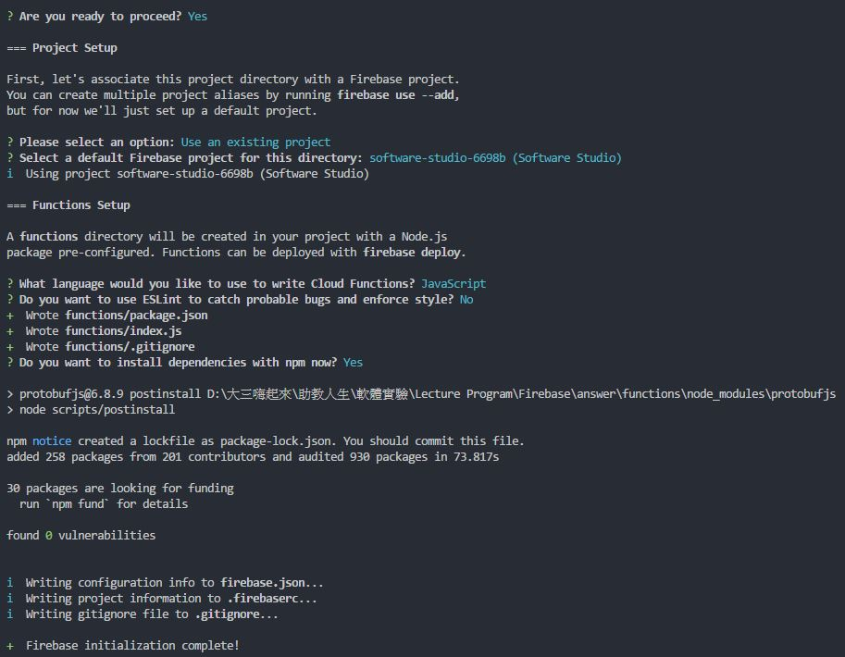
Cloud Function
First, enable cloud functions to your project.
Command : firebase init functions

Slide 85
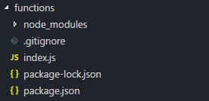
Cloud Function
Then you will get the following folder in your project.
Now, we are going to edit index.js to create our cloud functions.

Slide 86
Get Firebase admin
Just like what we did firebase.initializeApp(config) in our .js files. We initialize firebase again in index.js.
After that we can use the firebase functions, such as database or storage.
const admin = require('firebase-admin');
admin.initializeApp();
index.js

Slide 87
Create a New Function
This function is an HTTP endpoint. Any request to the endpoint results in ExpressJS-style Request and Response objects passed to the onRequest() callback.
https://expressjs.com/zh-tw/
Serve code
exports.addMessage = functions.https.onRequest(async(req, res) => {
// Grab the text parameter.
const original = req.query.text;
// Push the new message into the Realtime Database using the Firebase Admin SDK.
const snapshot = await admin.database().ref('/messages').push({ original: original });
// Redirect with 303 SEE OTHER to the URL of the pushed object in the Firebase console.
res.redirect(303, snapshot.ref.toString());
});
// This client-end function is equivalent to the previous cloud function
function addMessageLocal(text){
const snapchat = await admin.database().ref(‘/messages’).push(text);
}
Client code

Slide 88
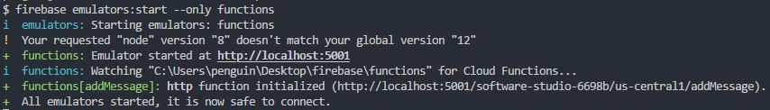
Setup Local Testing Server
Once you finish editing your cloud functions, you can start up a local server to test the correctness of your functions.
Command : firebase emulators:start --only functions

Slide 89
Use Cloud Functions (local)
After initialize firebase in your js code, you can get the functions you created.
Remember that if you are using local server to call cloud functions, you have to use firebase.functions().useFunctionsEmulator() to redirect to localhost server.
// connect to localhost server
firebase.functions().useFunctionsEmulator('http://localhost:5001');
//comment this line if you use formal cloud functions
// call function : addMessage
var addMessage = firebase.functions().httpsCallable(‘addMessage');
addMessage({text:uppercasemetoo}).then(()=>{});
Client code

Slide 90
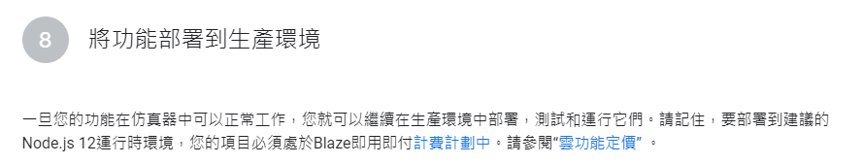
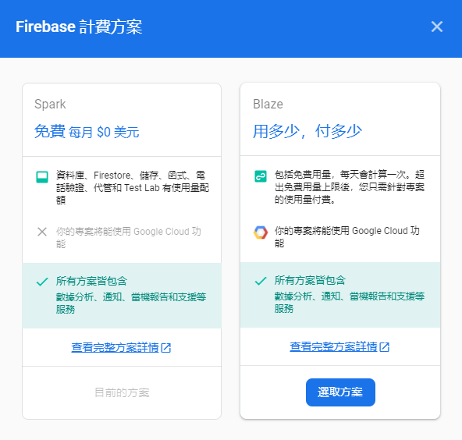
Deploy Cloud Functions
Deploy cloud function to server require upgrading firebase service to Blaze

Slide 91
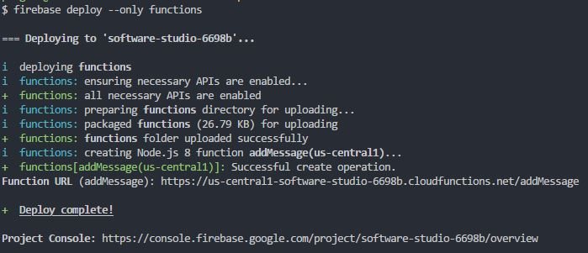
Deploy Cloud Functions
Deploy function to server make sure we don’t need to run server by ourselves
Command : firebase deploy --only functions

Slide 92
Use Cloud Functions
After deploy firebase cloud functions, you can use the functions you created.
// call function : addMessage
var addMessage = firebase.functions().httpsCallable(‘addMessage');
addMessage({text:uppercasemetoo}).then(()=>{});
Client code

Slide 93
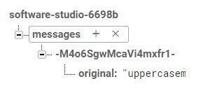
Demo
Enter the following url in your browser.
https://us-central1-[MY_PROJECT].cloudfunctions.net/addMessage?text=uppercasemetoo
Then go to firebase console and check your real-time database. If cloud functions setup successfully, you will have following structure.

Slide 94
Reference
Firebase Documentation
Firebase Get Started – Web
Firebase on the Web - Tutorials

Slide 95





